Slide 1

C++ FILE HANDLING

Slide 2

File handling introduction
Files are used to store data in a storage device permanently.
File handling provides a mechanism to store the output of a program in a file and to perform various operations on it.
In C++ we have a set of file handling methods.
These include:
ifstream, ofstream, and fstream.
Notes:
File handling is used to store a data permanently in computer. The data can be stored in secondary memory (hard disk) using file handling.
The I/O data can easily transferred from one computer to another by using files.
The C++ standard library provides fstream class for performing Read and Write operations.

Slide 3
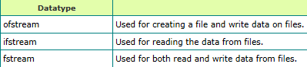
Methods of file handling
ofstream: Stream class to write on files
ifstream: Stream class to read from files
fstream: Stream class to both read and write from/to files.
Description
Notes:
So far, we have been using the iostream standard library, which provides cin and cout methods for reading from standard input and writing to standard output respectively. Now we will see how to read and write from a file. This requires another standard C++ library called fstream, which defines three new data types −

Slide 4
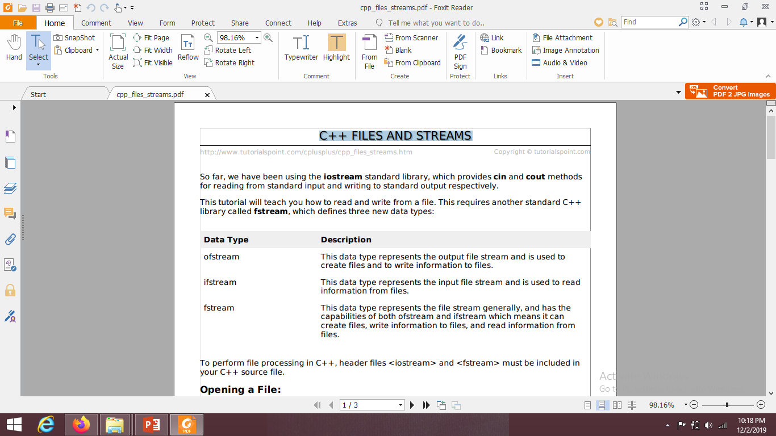
Methods of file handling

Slide 5

Functions in File Handling:
Description

Slide 6
Operations of File Handling
Following are the operations of File Handling. 1. Naming a file 2. Opening a file 3. Reading data from file 4. Writing data into file 5. Closing a file

Slide 7
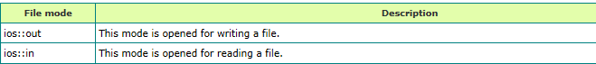
File opening modes
Default Open Modes :
ifstream | ios::in
ofstream | ios::out
fstream | ios::in | ios::out
Notes:
There are many other modes like binary, ate, app, trun but we will see only input output modes.
All these above modes can be combined using the bitwise operator (|).

Slide 8
Header Files
To perform file processing in C++, header files <iostream> and <fstream> must be included in your C++ source file.

Slide 9
Opening a File
Operation:
Open() function : open multiple files which uses the same stream object.
Function:
The fstream or ofstream object is used to open a file for writing and ifstream object is used to open a file for reading.
Syntax:
Stream_object.open (“file_name”, ios_base:: mode); where, First argument filename specifies the name of file and location. Second argument open() member function defines the mode in which the file should be opened.
Notes:
A file must be opened before you can read from it or write to it. Either the ofstream or fstream object may be used to open a file for writing and ifstream object is used to open a file for reading purpose only.

Slide 10
Closing a File
The close() function is used for closing a file.
When a program terminates, it automatically closes or flushes all the streams, releases all the allocated memory and closes all the opened files. But a good practice for programmer to close all the opened files before the program termination.
Syntax: void close();
A file must be closed after completion of all operation related to a file.

Slide 11
Writing or Reading
Writing to a File
The insertion operator (<<) is used to write information in a file.
The ofstream or fstream object is used instead of cout object.
Reading from a File
The extraction operator (>>) is used to read information from a file into your program.
The ifstream or fstream object is used instead of cin object.

Slide 12
Example: Open a file and Write into it
#include <iostream>
#include <fstream>
using namespace std;
int main ()
{ ofstream myfile; // ofstream object
myfile.open (“C\\users\\desktop\\example.txt“, ios_base::out); //open file
myfile << "Writing this to a file.\n"; //write into file
myfile.close(); //close the file after writing
return 0;
}
Notes:
fstream: Stream class to both read and write from/to files.
Ofstream is used for Stream class to write on files and here we will also create its object
Now we will open a file using this statement i.e. obj.open and inside the brackets we will use the path of the file where it is created and its mode which means in which mode you want to open it. Mode can be out mode for writing into the file or in mode for reading from a file. It is mandatory to close the file after using it.

Slide 13
Example: Open a file and Read from it
#include <iostream>
#include <fstream>
#include <string>
using namespace std;
int main ()
{ string line; //string variable for storing text
ifstream myfile; //ifstream object
myfile.open("C\\users\\desktop\\example.txt“,ios_base::in);
while ( getline (myfile,line) ) //read input
{
cout << line << '\n'; } //display the text
myfile.close(); // close the file
}
}
Notes:
ifstream: Stream class to read from files.
Ofstream is used for Stream class to write on files and here we will also create its object and string header file as we are dealing with string
Now we will open a file using this statement i.e. obj.open and inside the brackets we will use the path of the file where it is created and its mode which means in which mode you want to open it. Mode chere is in mode for reading from a file. It is mandatory to close the file after using it.
Now we will use loop and et the textline by line and display it . After that we will close the file

Slide 14
Read & Write Example:
Following is the C++ program which opens a file in reading and writing mode.
After writing information inputted by the user to a file, the program reads information from the file and outputs it onto the screen:

Slide 15
#include <iostream>
#include <fstream>
using namespace std; int main () { char name[50]; //writing into the file ofstream ofile; ofile.open("abc.dat"); cout << "Writing to the file" << endl; cout << "Enter your name: "<<endl; cin.getline(name, 50); cout<<endl; ofile << name << endl; ofile.close();
//reading from the file
ifstream ifile; ifile.open("abc.dat"); cout << "Reading from the file" << endl; ifile >> name; cout << name << endl; ifile.close();
return 0; }
Notes:
Now here we have an example to perform reading and writing operations. Here we have a character array to store name. First step is writing to a file for this we will use ofstream and its object. Open the file (here we have not used any mode). Write into the file. Cout statement will display text on you cmd screen that appears when you program executes. And it will take input from the user. This statement will be then written into the file using ofile object.

Slide 16
#include<iostream>
#include <fstream>
using namespace std;
int main()
{ int empno;
char name[10];
char dept[5];
char desig[5];
double basic;
ofstream ofile;
ofile.open("C:\\Users\\Sabina\\Desktop\\file3.txt",ios_base::out);
cout << endl<< "Enter empno";
cin >> empno;
cout << endl<< "Enter empname";
cin >>name;
cout << endl<< "Enter department";
cin >> dept;
cout << endl<< "Enter designation";
cin >> desig;
cout << endl<< "Enter basic pay";
cin >> basic;

Slide 17
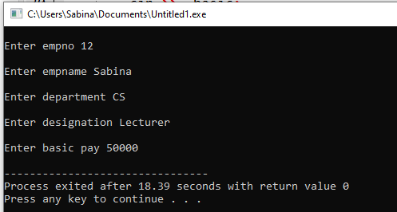
ofile << endl<< "Employee no";
ofile << empno;
ofile << endl<< "Employee Name";
ofile << name;
ofile << endl<< "Employee Department";
ofile << dept;
ofile << endl<< "Employee Designation";
ofile << desig;
ofile << endl<< "Employee Salary";
ofile << basic;
ofile.close();
}

Slide 18

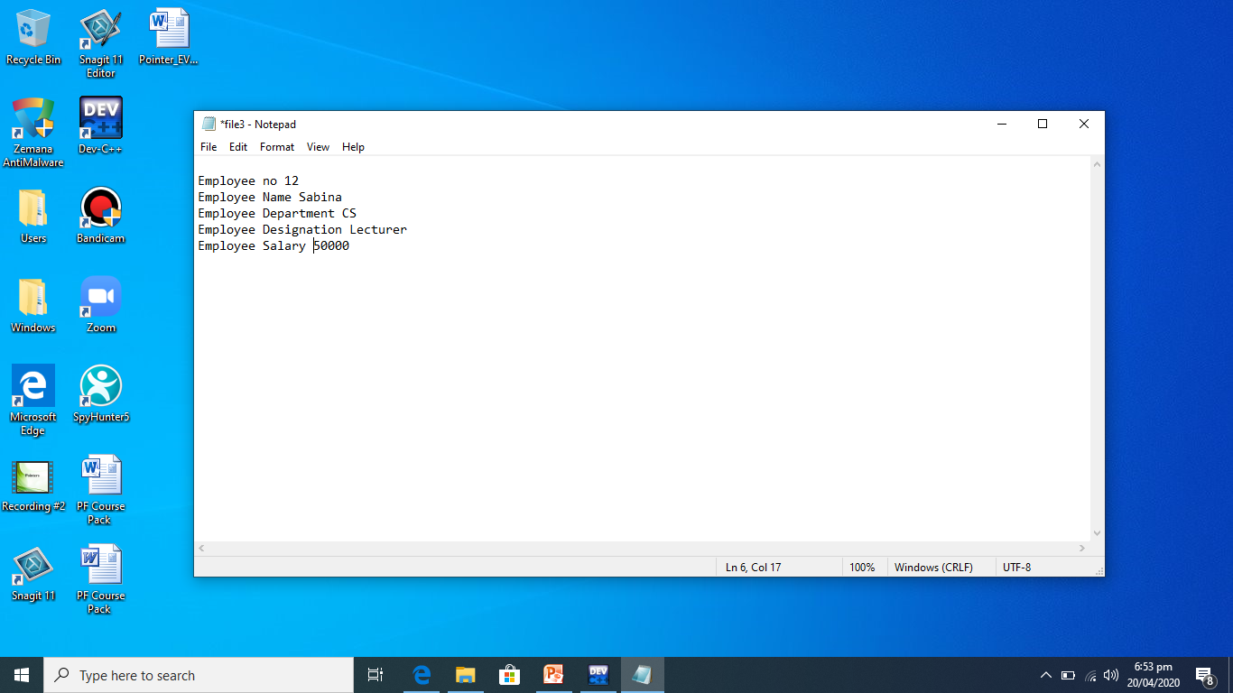

Slide 19
END

